Slide 1
Bionic Mechanical Goose Based on Water Surface SLAM Mapping
Goobot Project
December 10, 2021
Notes:
Hello everyone, the topic of my pre today is Bionic Mechanical Goose Based on Water Surface SLAM Mapping. We named this project as GOOBOT. Because the solution we finally chose is a bionic goose-shaped robot, so we named the robot GOOBOT, Also it means good robot.

Slide 2
Target & Anticipation
A bionic robot: precise control & autonomous driving
Physical structure: float on the water
Movement control: precise control of posture & movement
Route planning: identity the environment & plan the route autonomously
Bionic: harmoniously blend into the natural surroundings
Features: mini-robot、less noise、 bionic appearance
Interactive: interact with the environment and human
Other bionic structure or mechanical structure
Notes:
Firstly, I want to introduce some initial inspiration and goals of the project.
One day, Professor Zhu was walking by the Weiming Lake and thought: Can we make a type of water robot to help connect garbage and monitor water quality？So our project was born. We want to complete a water robot that can precisely control its actions and be intelligent enough to accomplish some tasks.
Now, let’s learn some basic features of the robot.
First of all, the physical structure, it must be able to float on the water, as it is a water robot, also it needs to have robustness in some scenes.
In terms of movement, it should be able to precisely control its own posture, speed, and position to achieve autonomous cruises according to the planned route.
And then information gathering, Before autonomously planning a path, it is also necessary to have the ability of learning the surrounding environment, such as:
- using its Visual or laser to gather information of the water surface and bank, processing the data and building models, and then autonomously plan a definite cruise route to complete the task expected
We also want the robot to be bionic, which means it can perfectly blend into the natural surroundings, without the feeling that it stands out or is disharmonious
-This requires our robots to be smaller, emit less noise when running, and have an appearance similar to some animals.
- At the same time, in order to be enjoyable, it can also interact with people and complete some funny actions.
Refering to Professor Zhu’s requirements for amphibious, bionic fins or other mechanical structures may be added in the future.

Slide 3
Outline
SLAM
PID Control
Communication problems of each module
Physical structure design
Electrical system design
Preliminary investigation
Current work
Sensors and control board
Mechanical structure
Notes:
Currently we divide the project into six parts,
First of all, we conducted a detailed investigation, however, there are few successful examples of small surface robots. Most of them are for large surface robots or underwater robots.
So we independently design the shape and physical structure of the goose

Slide 4

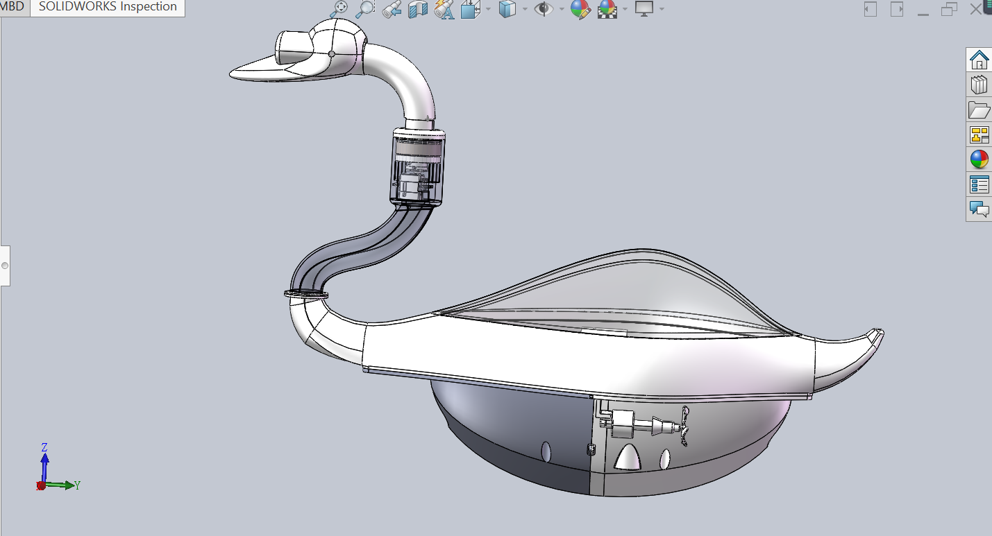
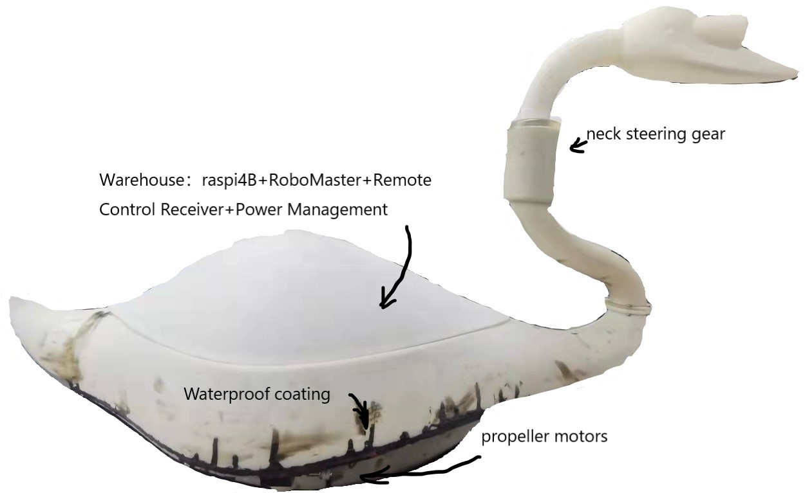
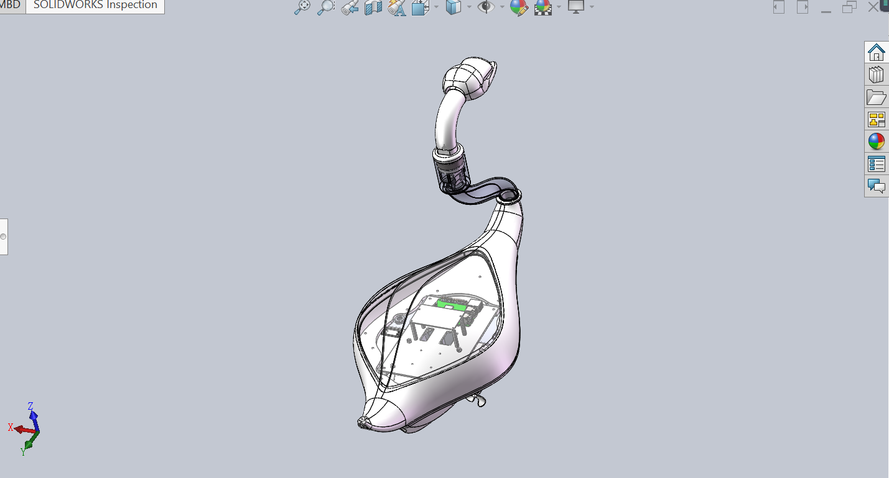
Physical structure
Camera
Notes:
We place the center of buoyancy directly above the center of gravity, to ensure that its slight sideways will not cause the instability of the overall system, otherwise it may lead to overturning.
-The belly of the goose is hollowed out, There are battery storage unit and development boards. Two propeller motors are symmetrically equipped under the abdomen of the goose, used for the power of the movement.
-The neck of the goose is equipped with a steering gear, which can complete the rotation of the gooseneck.
-And the head of the goose is equipped with a camera, responsible for collecting visual information of the environment.
Of course, the current bionic robot goose still has large space left to install more sensors and other equipment

Slide 5
Outline
SLAM
PID Control
Communication problems of each module
Physical structure design
Electrical system design
Preliminary investigation
Current work
Sensors and control board
Mechanical structure

Slide 6
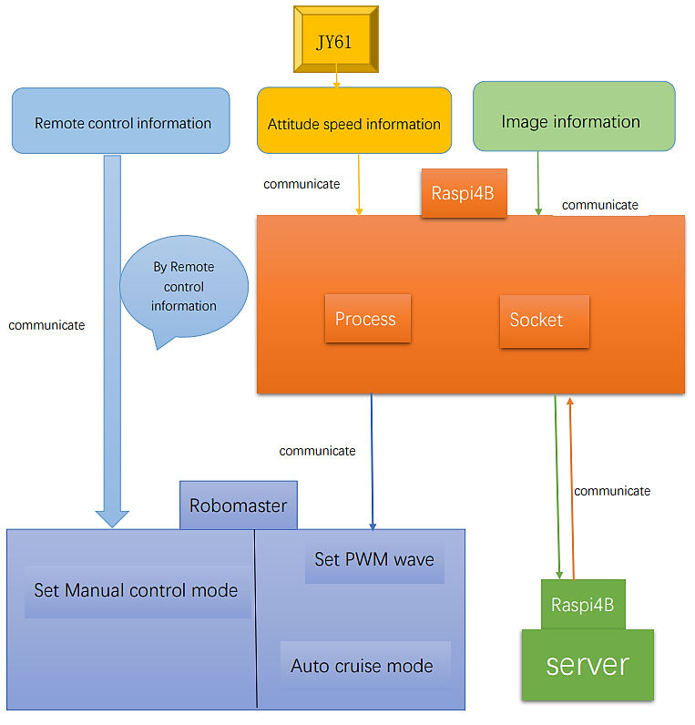
Sensors & control board
Current work
Current work
Notes:
This picture shows the electrical system design of goobot.
At present, there are three types of sensors, transmitting the external information into the system.
The remote control can control the goose in case of some special events, such as if the robot failed to conduct the right movement, we can set the manual control mode.
The JY61 gyroscope is responsible for detecting the posture, and the detecting results are passed to the Raspberry as the input of the PID.
The camera is responsible for taking real-time images for Slam.
We choose robomaster as the motion control board, to convert motion information into PWM wave output, so as to control the speed of the motor and complete the control of behavior.
The Raspberry serves as the upper board, receiving gyroscope information, doing PID control, and outputs it to the robomaster board for execution.
The real-time picture is transmitted to the server through the socket, and the server builds the map in real time. When the analyzing and map-building is done, the server can send instructions to guide the goose's direction or cruise route.

Slide 7
Outline
SLAM
PID Control
Communication problems of each module
Physical structure design
Electrical system design
Preliminary investigation
Current work
Sensors and control board
Mechanical structure
Notes:
The next stage is to realize the communication between various modules, so that they can be linked as a whole.

Slide 8
Sensors & control board
Current work
Current work
Notes:
We can also look at this picture. Except that the communication between the Raspberry and the server is still being debugged, the other communication functions have been successfully developed.
The figure also marks the next stage of work focusing on PID debugging and SLAM development.

Slide 9
finished work
Hardware debug、 Hardware debug、 Hardware debug……
Hardware design and test
Achieve the communication between Raspberry and Robomaster.
Initialize the propeller motors. Initialize the ESC named “Haotiao”.
Achieve the communication between Robomaster and motors
Set up the environment
Get the posture parameters.
Unachievable: stabilizing z-axis deviation with the acceleration of gravity
Raspberry related work
Notes:
Finally, let’s summarize the work done on the hardware.
读PPT
Chen Yang will talk about the detailed situation here
The biggest difficulty is that, we are kind of unfamiliar with the IDE and set up the environment. Here I will talk about the problems encountered in detail.
We tried to calculate the quaternion through the angular velocity and angular acceleration returned by the six-position sensor, and then integrate it into Euler angles.
Then Eliminate drift errors through the acceleration of gravity.
But according to tutor's theoretical analysis, we found that the acceleration of gravity cannot eliminate the drift of the yaw angle anyway, it eliminates the pitch angle and roll angle.
In the end we decided to replace the nine-position sensor to solve the problem.

Slide 10
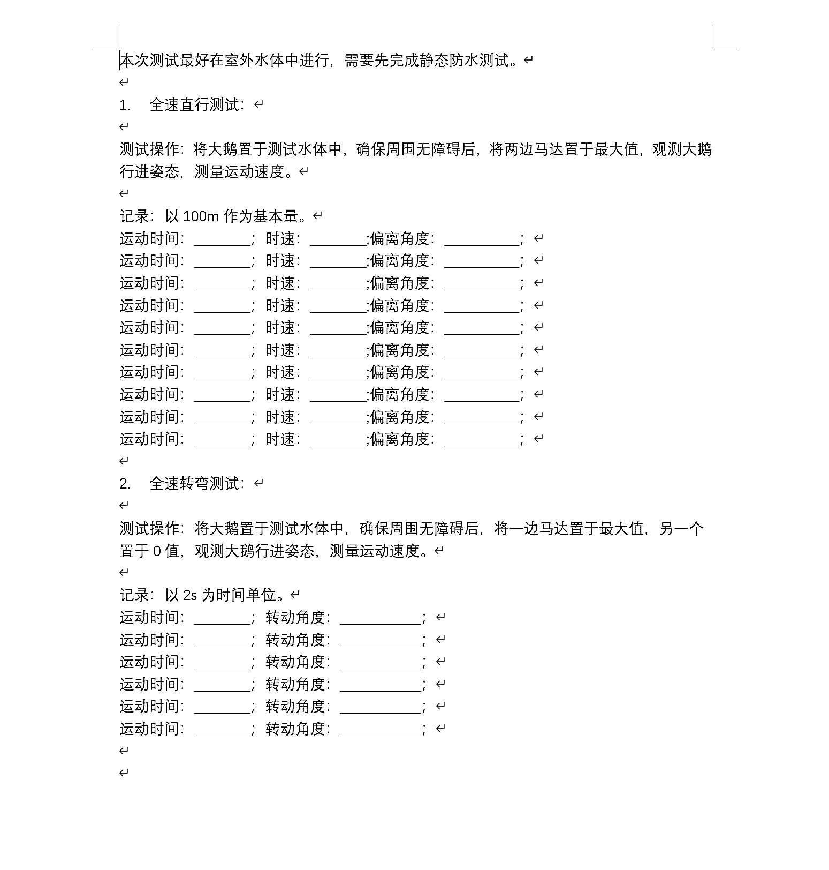
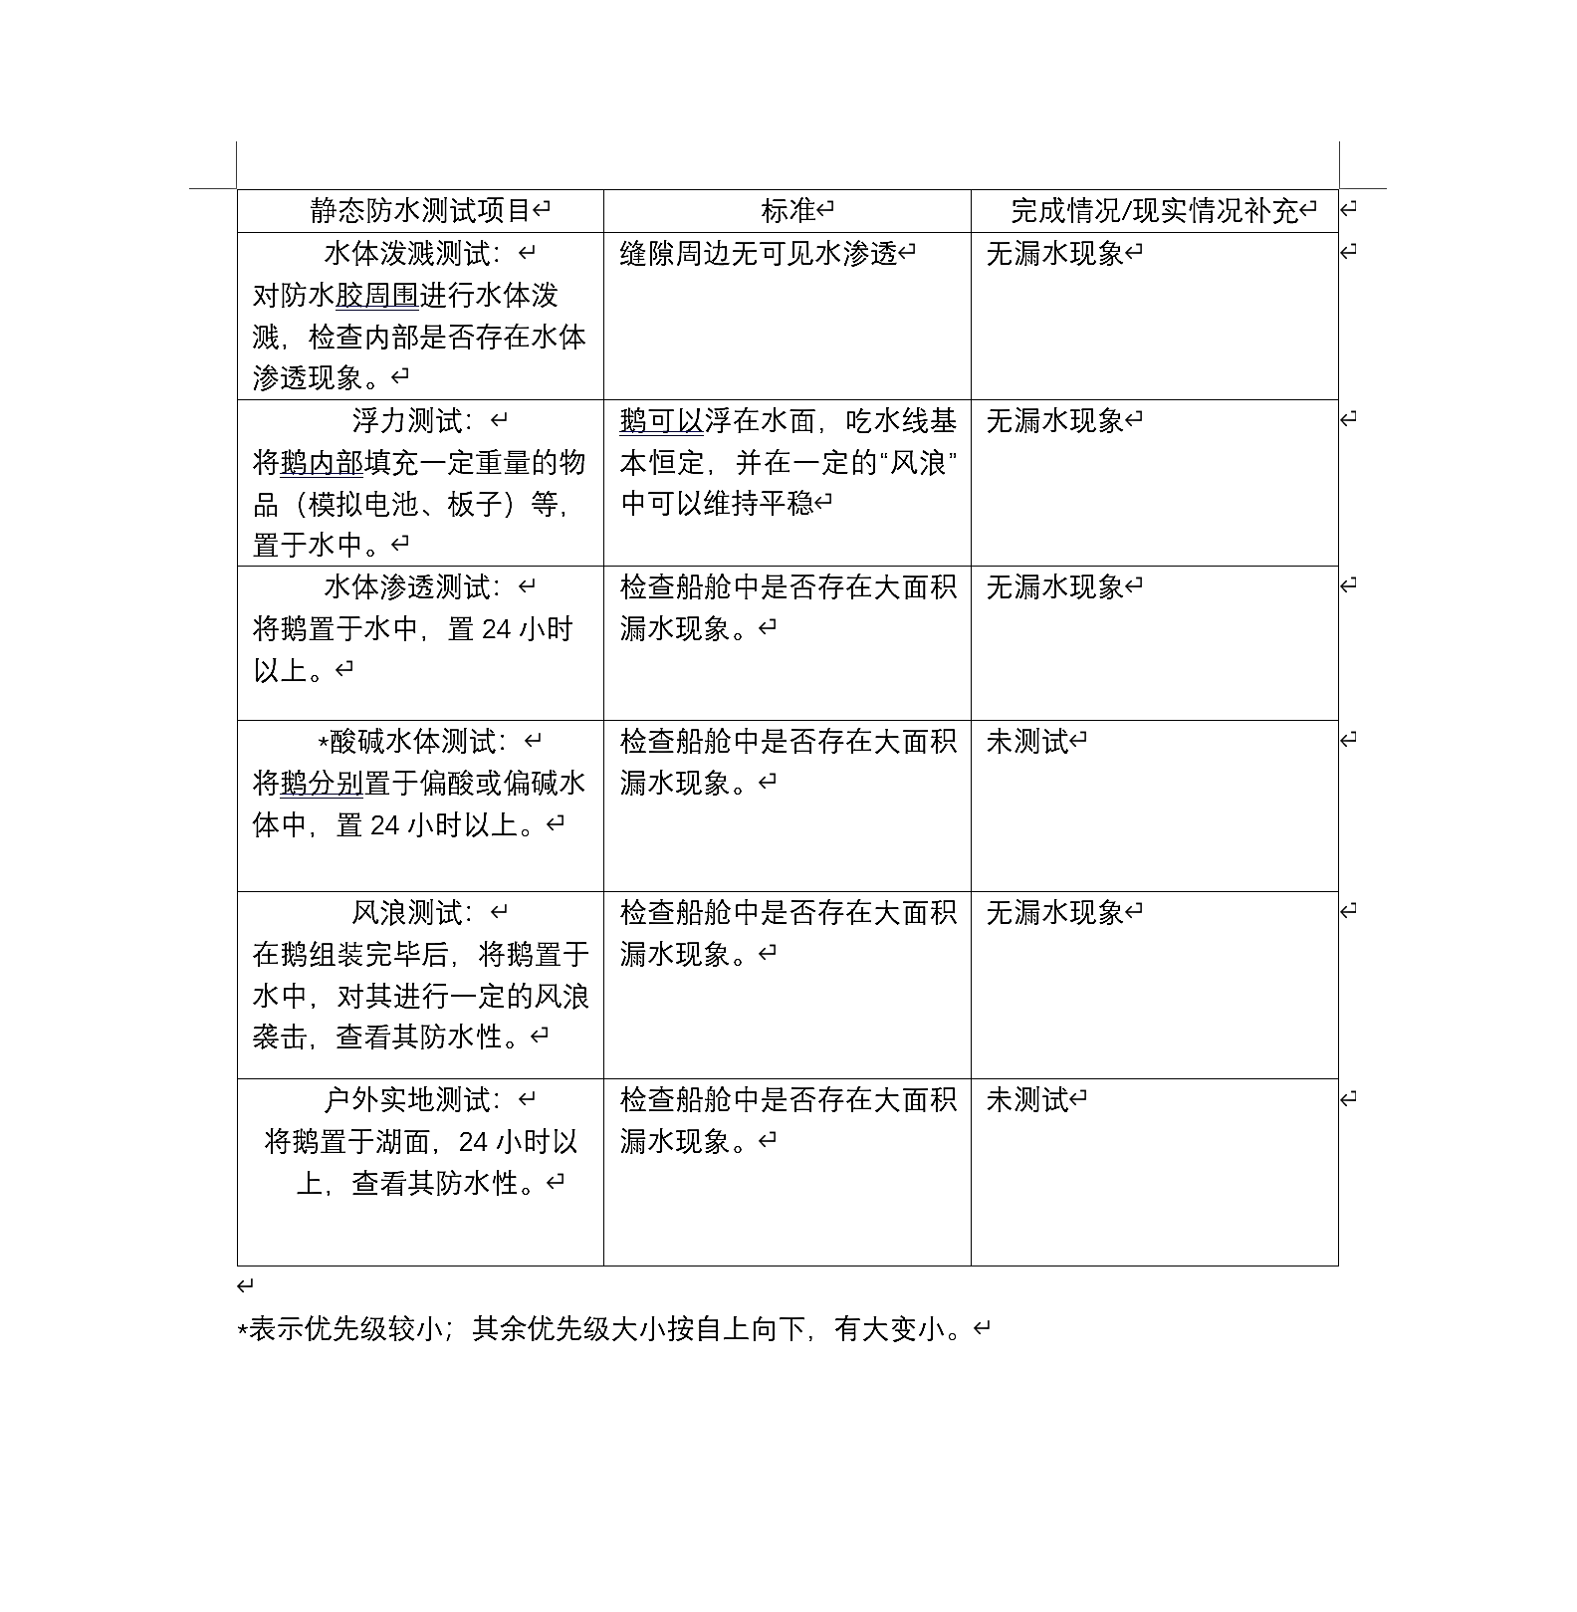
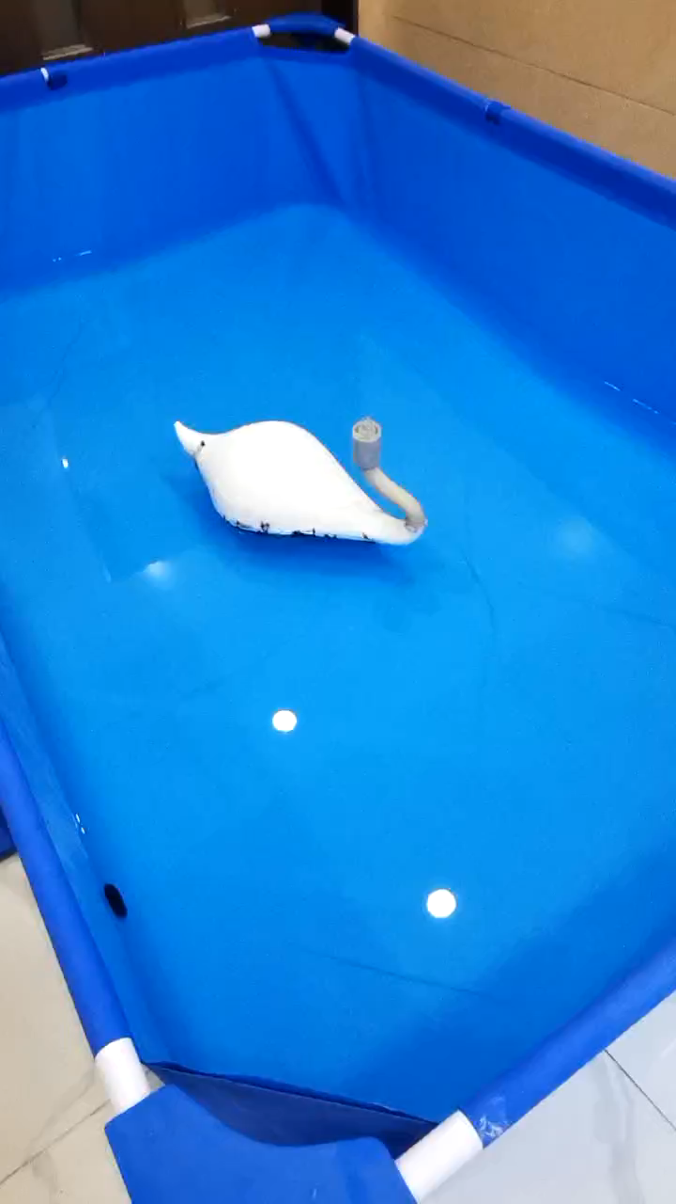
Test Work

Slide 11
SLAM
Simultaneous Localization and Mapping
Can I use the camera to complete the slam ?
Why I need mapping function ?
Autonomous cruise need a map
Initializing mapping in unknown waters is important
Picking up rubbish needs to locate rubbish location
There is no mature technology in this area
Notes:
The next topic is the slam part. Its full name is Simultaneous Localization and Mapping
Based on our original design, Can I use the camera to complete the slam?
The difficulty is that, the single camera mapping can only infer the size of the object, it cannot judging the distance between the object and the camera itself. So it perform the task by judging the difference in the size of the object between the two frames. What’s more , it has no idea of its own state such as its velocity.
And there are very few feature points recognized by the camera on the water surface, which adds to the difficulty.
Based on the certain unknown waters that we want to map, such as Weiming Lake, we can sum up the information on the shore, to outline the movable range of the goobot, and then deal with the garbage on the water surface Perform modeling and calibration.

Slide 12
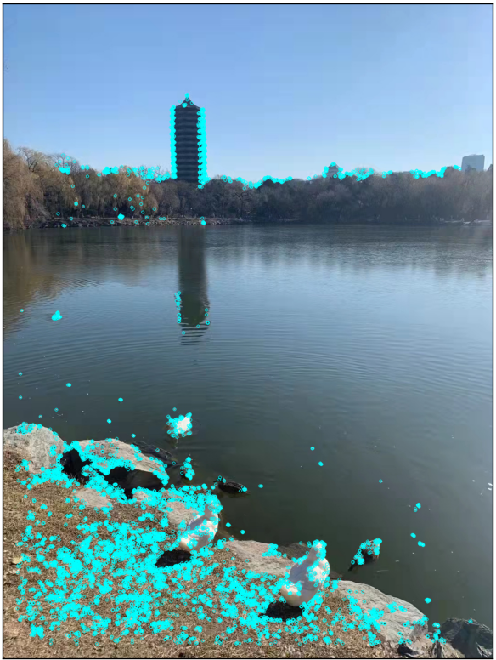
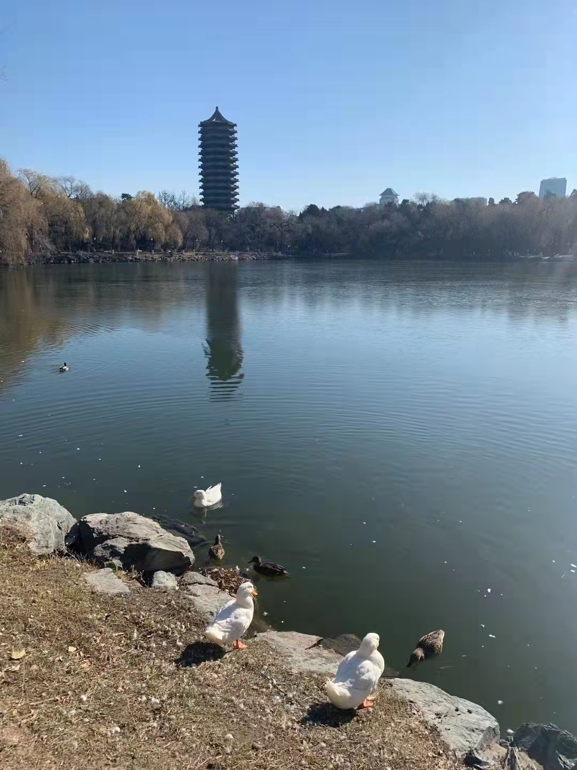
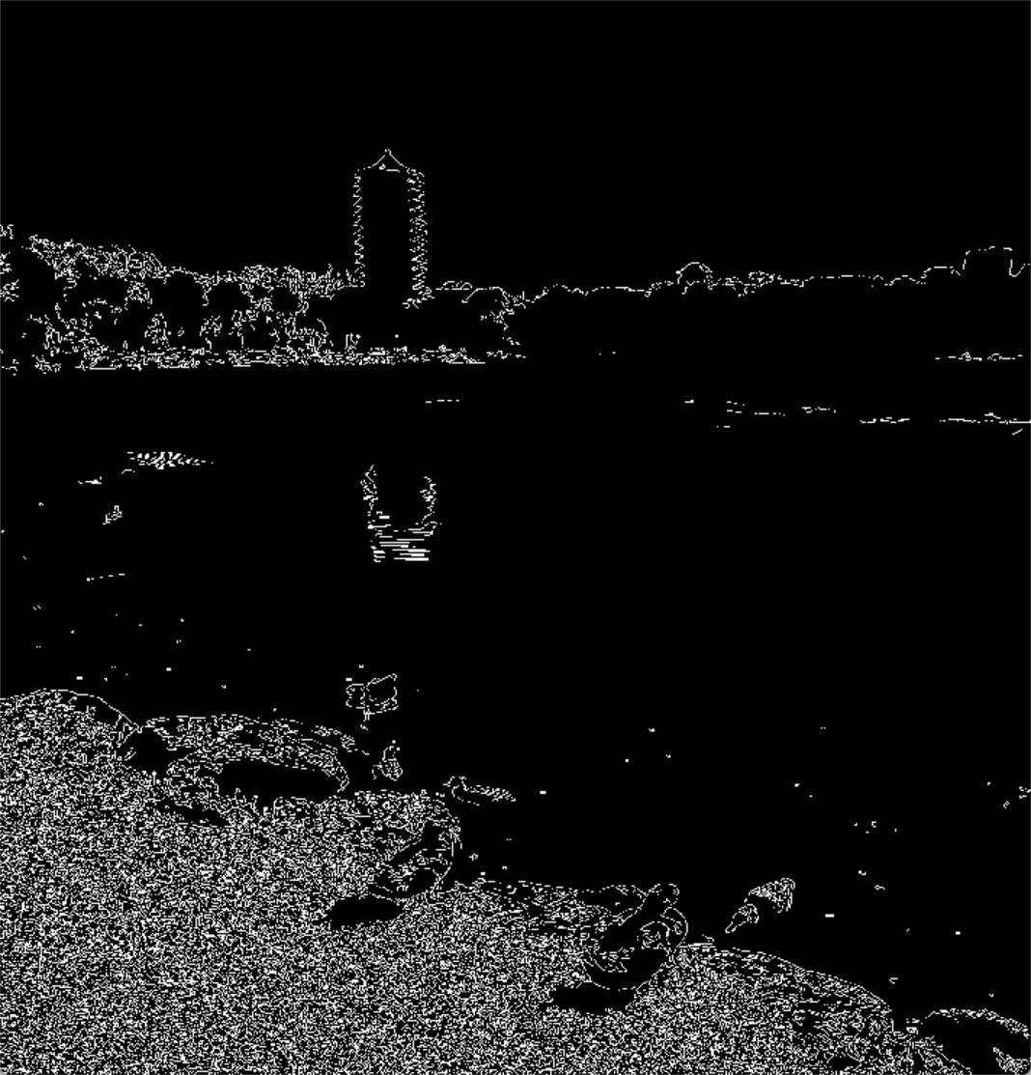
Difficulty
ORB
Few points
Canny
Reflection
Notes:
I conducted some experiments with the two existing algorithms. ORB corner detection algorithm and canny edge detection algorithm.
读PPT

Slide 13
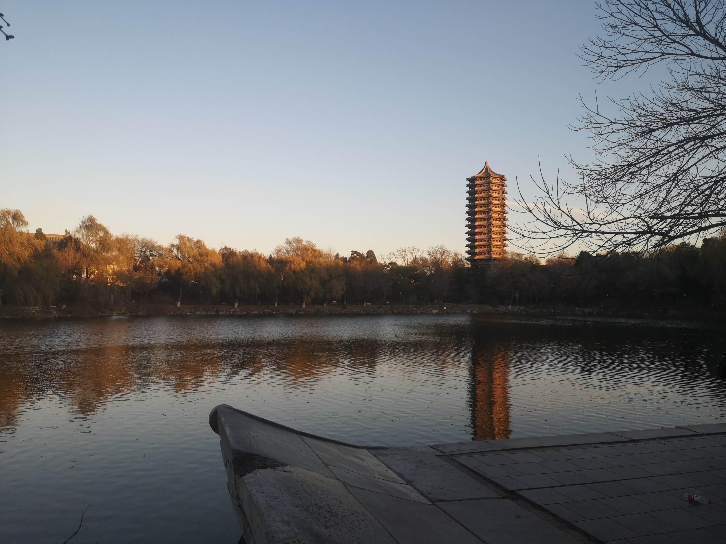
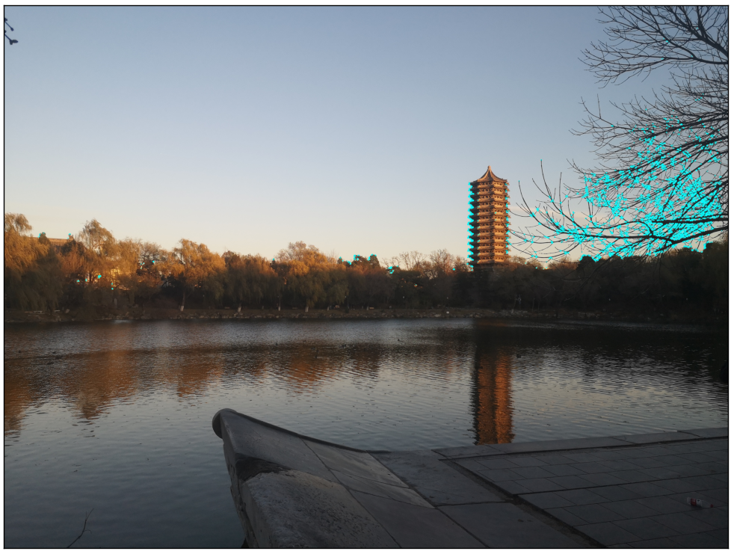
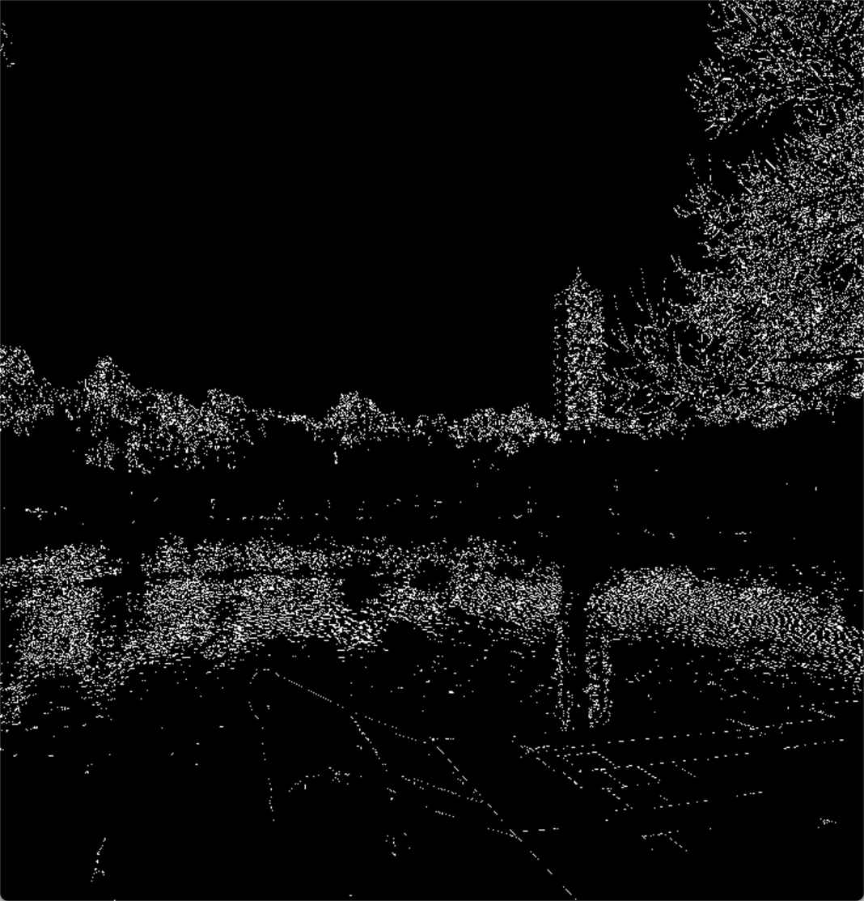
Few points
Water ripples:
cause greater interference in the extraction of image edge points
The number of corner points will be wasted in the environment on the bank
ripple

Slide 14
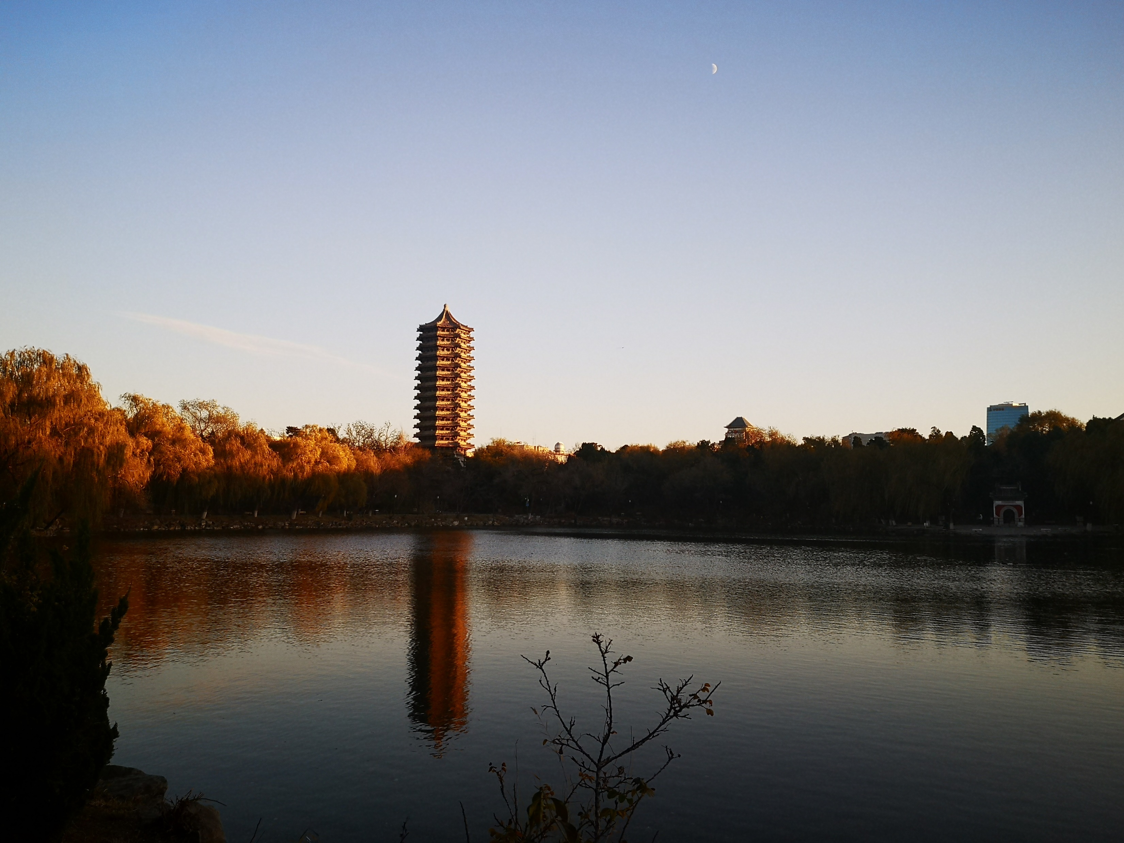
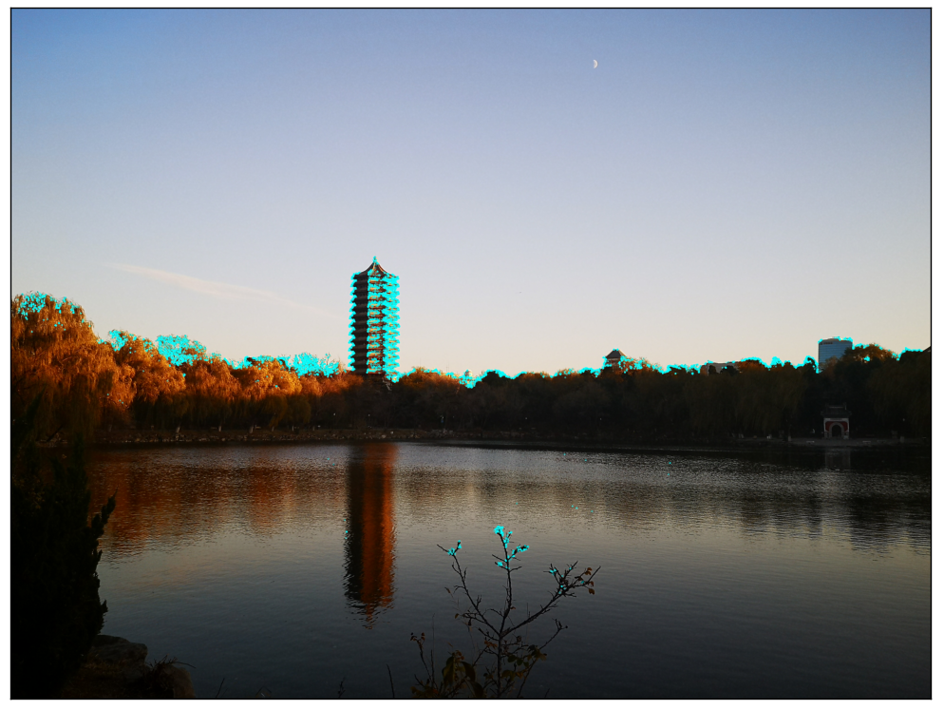
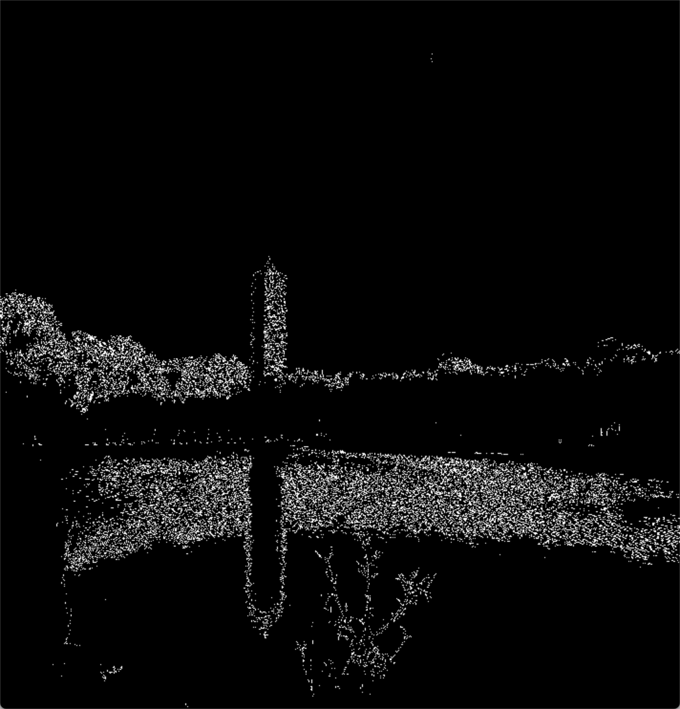
Reflection + ripples
poor

Slide 15
Which SLAM should choose/create ? (Goals for the next stage)
ORB-SLAM2 ?
May get sparse feature points, the final effect is poor
Active SLAM ?
Increase cruise action, low efficiency
Not suitable for dynamic systems like water surface
——Efficient、Good performance、 Suitable for dynamic systems

Slide 16
Next step
Launch test !
Get data from experiments to optimize PID control
Get pictures from Goose perspective to help SLAM work
Notes:
In our next stage,
we first want to conduct a launch test first, and collect some data as a basis for subsequent debugging.

Slide 17
Thank you

